Slide 1
Elastic Buffer
K.LOKESH
Chipweave Technologies Private Limited

Slide 2
Elastic Buffer
An elastic buffer is a small FIFO memory used between two clock domains to absorb clock frequency or phase differences, preventing data loss or overflow during data transfer.
Used in clock domain crossing (CDC) situations.
Handles clock skew, jitter, and rate mismatch.
Temporarily stores data to smoothen data flow.
Commonly used in high-speed interfaces (PCIe, USB, Ethernet, UCIe).

Slide 3
Elastic Buffer in PIPE Interface
In the PIPE (PHY Interface for PCI Express), an elastic buffer is used at the receiver to compensate for clock frequency and phase differences between the MAC (Link layer clock) and the PHY (recovered clock).
How It Works (PIPE Flow)
PHY Rx recovers clock from incoming serial data
Data is written into the elastic buffer using the recovered Rx clock
MAC reads data using the local reference clock
The elastic buffer absorbs:
Clock drift
SSC (Spread Spectrum Clocking) differences
Minor frequency mismatches

Slide 4
Elastic Buffer in PIPE Interface
Why Elastic Buffer Is Needed in PIPE
MAC and PHY clocks are not perfectly synchronized
Prevents buffer underflow or overflow
Ensures continuous, error-free data delivery

Slide 5
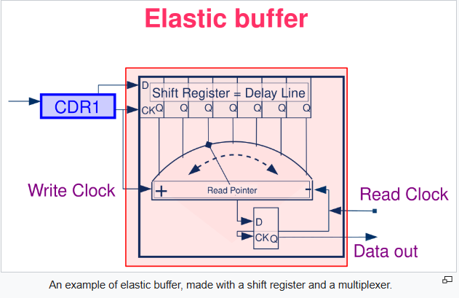
Elastic Buffer
This is an example of an elastic buffer implemented using a shift register (delay line) and a read pointer.
It sits between two different clocks:
Write Clock (from CDR / PHY side)
Read Clock (from MAC side)

Slide 6
Elastic Buffer
1️⃣ CDR1 (Clock Data Recovery)
Recovers the clock from incoming serial data.
This recovered clock becomes the Write Clock.
Data is written into the shift register using this clock.
2️⃣ Shift Register = Delay Line
Acts like a temporary storage pipeline
Each flip-flop stores one stage of data
As the write clock ticks, data shifts forward stage by stage
Think of it like a moving conveyor belt of data.

Slide 7
Elastic Buffer
3️⃣ Read Pointer (Multiplexer Control)
The curved arrow shows the read pointer movement
The read pointer selects which stage of the shift register to read from
Controlled by the Read Clock
If write clock is slightly faster → pointer adjusts
If read clock is slightly faster → pointer adjusts
This prevents:
Overflow
Underflow
4️⃣ Data Out
Selected data is sent to the MAC using the Read Clock.

Slide 8
Thank You !

